Slide 1
South Carolina Forestry Commission: E-Bike Evaluation

Slide 2
Contents
Project Background
Current Regulation
Impact of E-Bikes
Case Studies
Conclusions

Slide 3
Project Objectives
Provide guidance on future e-bike policies in SCFC-managed forests
Project Objectives
SCFC issued a request to evaluate the potential expansion of e-bike access on recreational trails within its state forests. As public interest in e-bike usage grows, SCFC must balance recreational access with environmental sustainability, user safety, and compliance with state and federal policies. This evaluation provides SCFC with the necessary insights to make informed policy decisions while ensuring that South Carolina’s state forests continue to serve the public responsibly.
Our role in this project is to identify, analyze, and synthesize the key factors influencing e-bike policy decisions, ensuring that SCFC has a clear understanding of: The potential environmental and trail-use impacts of expanded e-bike access. The comparison of other state and federal regulations regarding e-bike usage, and the lessons that can be drawn. The trade-offs between user accessibility, sustainability, and land-use priorities within SCFC’s management framework. Priority Metrics Group will focus research efforts on three impact areas and sub-categories associated with each of these three areas of concern: Natural – erosion, water quality, habitat disturbance, trail building, fire risk Safety – e-bike user injury, non-user injury Social – speed, user volumes/conflicts, user behavior/trail etiquette, increased access/longer distance/battery range, increased non-cyclist access Research was limited to published materials and reports that are available in the public domain.

Slide 4
Contents
Project Background
Current Regulation
Impact of E-Bikes
Case Studies
Conclusions

Slide 5
Legal Definitions
Consumer Product Safety Commission
E-bikes are regulated by the Consumer Product Safety Commission (CPSC) as bicycles under a 2002 law. The CPSC is a federal agency that regulates the sale and manufacture of products, but not how they are used.
According to federal law and CPSC regulations a ‘‘low-speed electric bicycle’’ is:
“A two-or-three-wheeled vehicle, with fully operable pedals, and an electric motor of less than 750 watts, whose maximum speed on a paved level surface, when powered solely by such a motor while ridden by an operator who weighs 170 pounds, is less than 20 mph.”
E-bikes that have assisted speeds higher than 20 mph are only lawfully e-bikes for the purpose of federal regulations if they require pedaling for assist at those higher speeds (Class 3 e-bikes).
Federal Law
Federal law generally does not say anything about the use of e-bikes, with one exception. Federal law provides that e-bikes can be used on federally funded non-motorized trails where state and local regulations permit. [23 USC 217(h)(4)] Oddly, this exception also puts one additional regulation on e-bikes used on those trails – e-bikes used on federally funded non-motorized trails must weigh under 100 pounds.[23 USC 217(j)(2)] In 2020, the Bureau of Land Management adopted regulations that will allow land managers to allow e-bikes on many non-motorized trails on public land.
Sources: https://bikeleague.org/take-action/policy-advocacy/on-the-issues/e-bikes/

Slide 6
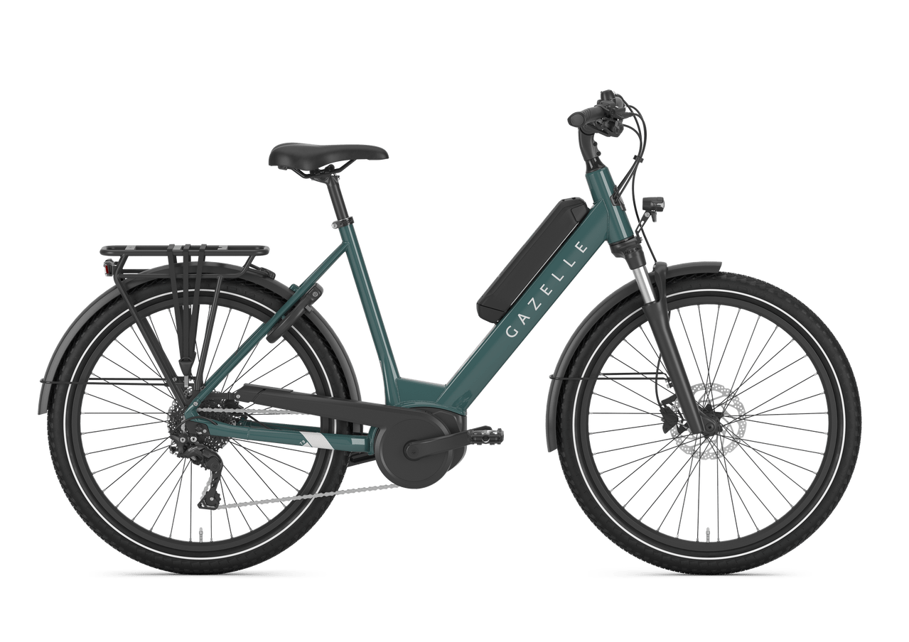
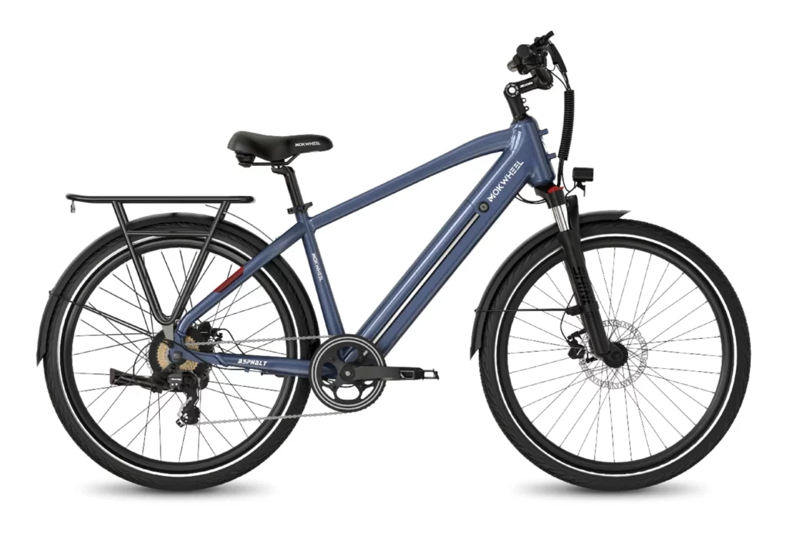
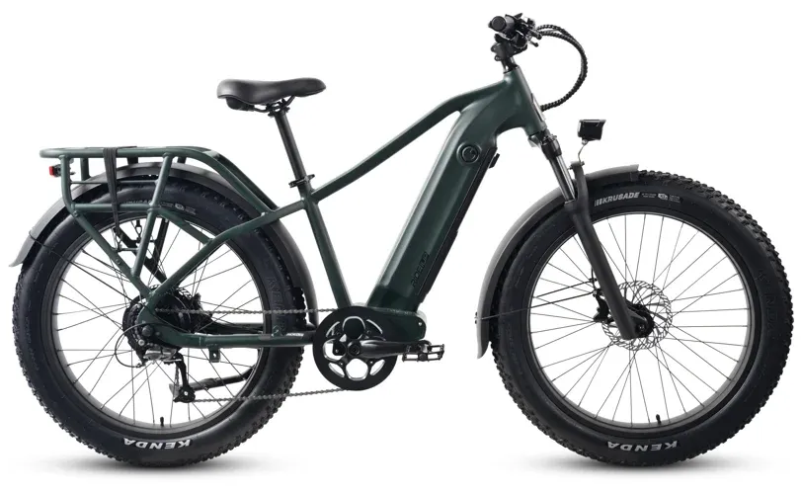
E-bike Classification
PeopleForBikes developed a three-tiered classification system for e-bikes which has since been widely adopted at state and federal levels
 | Class 1 | Class 2 | Class 3
Pedal-Assist | Yes | Yes | Yes
Throttle | No | Yes | No
Max Speed | 20 mph | 20 mph | 28 mph
Speedometer | Not Required | Not Required | Mandatory

Slide 7


Current SCFC Regulations
There are two to five SCFC Forests that will be affected by e-bike regulations
Harbison State Forest
Bicycles permitted only on designated trails
No motorized bikes or off-road vehicles are permitted on trails
Must wear an approved helmet when riding.
Manchester State Forest
Three trails for motorcycles and ATVs
Trails are directional
Must wear a helmet
May not ride motorcycles or ATVs on roads
Bicycle riding allowed
Poe Creek, Sand Hills, and Wee Tee State Forests
No mention of riding/riding regulations, although Poe Creek does provide users access to a bike rack
Harbison State Forest
Manchester State Forest

Slide 8











USDA Forest Service Guidance
USDA recent regulations allow the Local Forest Service to assess non-motorized trails and designate if e-bikes and which e-bike classes are allowed on each trail
General Criteria for Roads, Trails, and Areas
In designating NFS roads, NFS trails, and areas on NFS lands for motor vehicle use or OSV use, consider effects on:
NFS Natural and Cultural Resources
Public Safety
Provision or Recreation Opportunities
Access Needs
Conflicts Among Uses of NFS Lands
Need for Maintenance and Administration
Availability of Resources for Maintenance and Administration
Other Considerations
Effects of Combinations of Vehicle Types and Classes
If Separate Routes for User Groups are Needed
Must Conduct Engineering Analysis
Lack of Resources Shouldn’t be the Only Factor

Slide 9










USDA Forest Service Guidance continued
Consider and document, with the objective of minimizing:
Damage to Soil. Watershed, Vegetation, etc.
Harassment of Wildlife and Wildlife Habitats
Conflict with Existing or Proposed Land Uses
Conflict Among Different Classes of Motor Vehicles
Consider and document:
Whether Trails are Already Managed for Bicycle Use
Environmental Analysis
Sound, Emissions, etc. and Proximity to Population
No E-Bikes on National Scenic Trails
Whether E-Bike Use is Comparable to Bikes on Specific Trails
Which Classes Should Be Allowed
Existing Trail Management Objectives (TMOs)

Slide 10
Summary of State Regulations
Classification, helmet use and trail restrictions
 | E-Bike Classification | Helmet Requirements | Path-Trail Usage Restrictions
Alabama | Motor-driven cycles | Riders under 14 must wear a helmet | Allowed on roads and multi-use paths
Alaska | Motor-driven cycles | Riders under 14 must wear a helmet | Allowed on roads and multi-use paths
Arizona | Bicycles | No helmet laws | Allowed on roads, bike paths, and multi-use paths
Arkansas | Bicycles | Class 3: Riders under 21 must wear a helmet | Local governments may restrict use on bike paths
California | Three classes (1, 2, 3) | Riders under 17 must wear a helmet | Classes 1 & 2 allowed on bike paths, Class 3 may have restrictions
Colorado | Bicycles | No helmet laws | Allowed on roads, bike paths, and multi-use paths
Connecticut | Bicycles | Riders under 16 must wear a helmet | Classes 1 & 2 allowed on bike paths, Class 3 may have restrictions
Delaware | Bicycles | Riders under 16 must wear a helmet | Allowed on roads, bike paths, and multi-use paths
Florida | Bicycles | Riders under 16 must wear a helmet | Not allowed on sidewalks, allowed on bike paths under human power alone

Slide 11
Summary of State Regulations
Classification, helmet use and trail restrictions
 | E-Bike Classification | Helmet Requirements | Path-Trail Usage Restrictions
Georgia | Bicycles | Riders under 16 must wear a helmet | Allowed on roads, bike paths, and multi-use paths
Hawaii | Low-speed electric bicycles | Riders under 16 must wear a helmet | Allowed wherever bicycles are allowed
Idaho | Low-speed electric bicycles | No helmet laws | Allowed wherever bicycles are allowed
Illinois | Low-speed electric bicycles | No helmet laws | Allowed on roads, bike paths, and trails
Indiana | Bicycles | No helmet laws | Allowed wherever bicycles are allowed
Iowa | Low-speed electric bicycles | No helmet laws | Allowed wherever bicycles are allowed
Kansas | Bicycles | No helmet laws | Allowed wherever bicycles are allowed
Kentucky | Bicycles | No helmet laws | Allowed wherever bicycles are allowed
Louisiana | Bicycles | Riders must be 12+ to ride Class 3 | Allowed wherever bicycles are allowed
Maine | Three classes (1, 2, 3) | No helmet laws | Class 3 allowed on roads with speed limits ≤ 25 mph

Slide 12
Summary of State Regulations
Classification, helmet use and trail restrictions
 | E-Bike Classification | Helmet Requirements | Path-Trail Usage Restrictions
Maryland | Three classes (1, 2, 3) | Riders 16+ must wear a helmet for Class 3 | Allowed wherever bicycles are permitted
Massachusetts | Two classes (1, 2) | No helmet laws | Not allowed on sidewalks
Michigan | Three classes (1, 2, 3) | No helmet laws | Allowed wherever bicycles are allowed
Minnesota | Bicycles | No helmet laws | Allowed wherever bicycles are allowed
Mississippi | Bicycles with motors attached | No helmet laws | Allowed wherever bicycles are allowed
Missouri | Bicycles | No person under 16 shall operate Class 3 | Allowed wherever bicycles are allowed
Montana | Electrically assisted bicycles | Riders under 18 must wear a helmet | Allowed wherever bicycles are allowed
Nebraska | Electrically assisted bicycles | No helmet laws | Allowed wherever bicycles are allowed
Nevada | Three classes (1, 2, 3) | No helmet laws | Allowed wherever bicycles are allowed
New Hampshire | Bicycles | Riders under 18 must wear a helmet for Class 3 | Allowed wherever bicycles are allowed
New Jersey | Three classes (1, 2, 3) | Riders under 17 must wear a helmet | Allowed on roads and bike paths

Slide 13
Summary of State Regulations
Classification, helmet use and trail restrictions
 | E-Bike Classification | Helmet Requirements | Path-Trail Usage Restrictions
New Mexico | Mopeds | No helmet laws | Not allowed on sidewalks
New York | Three classes (1, 2, 3) | Class 3: Riders under 18 must wear a helmet | Allowed on roads and bike paths
North Carolina | Electric-assisted bicycles | No helmet laws | Allowed wherever bicycles are allowed
North Dakota | Motorized bicycles | No helmet laws | Allowed wherever bicycles are allowed
Ohio | Electric bicycles | Class 3: Riders must wear a helmet | Allowed on bike paths
Oklahoma | Bicycles | Riders must be 16+ for Class 3 | Allowed wherever bicycles are allowed
Oregon | Three classes (1, 2, 3) | No helmet laws | Allowed wherever bicycles are allowed
Pennsylvania | Pedalcycles with electric assist | No helmet laws | Allowed wherever pedalcycles are allowed
Rhode Island | Three classes (1, 2, 3) | No helmet laws | Same road restrictions as bicycles
South Carolina | Electric-assist bicycles, bicycles with helper motors | No helmet laws | Allowed wherever bicycles are allowed

Slide 14
Summary of State Regulations
Classification, helmet use and trail restrictions
 | E-Bike Classification | Helmet Requirements | Path-Trail Usage Restrictions
South Dakota | Electric bicycles | No helmet laws | Class 3 not allowed on bike paths
Tennessee | Bicycles | Riders under 16 must wear a helmet | Allowed wherever bicycles are allowed
Texas | Three classes (1, 2, 3) | No helmet laws | Allowed wherever bicycles are allowed
Utah | Three classes (1, 2, 3) | Riders under 18 must wear a helmet | Allowed on bike paths, not on sidewalks
Vermont | Three classes (1, 2, 3) | No helmet laws | Allowed wherever bicycles are allowed
Virginia | Electric power-assisted bicycles | Class 3: Riders must wear a helmet | Allowed wherever bicycles are allowed
Washington | Three classes (1, 2, 3) | No helmet laws | Only allowed on motorized trails and forest roads
West Virginia | Bicycles | Riders under 15 must wear a helmet | Allowed wherever bicycles are allowed
Wisconsin | Three classes (1, 2, 3) | Riders under 16 must wear a helmet | Allowed wherever bicycles are allowed
Wyoming | Bicycles | No helmet laws | Allowed wherever bicycles are allowed

Slide 15
Contents
Project Background
Current Regulation
Impact of E-Bikes
Case Studies
Conclusions

Slide 16
Environmental Impacts
Class 1 e-bikes will have comparable environmental impacts to analog bikes; Class 2 may cause more damage to trails
Concern | Legitimacy | Relevancy | Sentiment
Trail Degradation | Moderate | High | Class 2 e-bikes likely would have negative impacts on trail erosion; Class 1 e-bikes have similar effects on trails as analog mountain bikes.
Impact on Wildlife | Moderate | High | Classed e-bikes have comparable impacts on wildlife to analog bikes; they are not meaningfully louder than analog bikes and so their radius of disturbance is the same.
Increased Trail Use | Low | High | If a trail is intended for public use and use by mountain bikers, then increased trail usage should not be discouraged.
Battery Production | Moderate | Low | Environmental concerns around battery production would not affect and are outside the scope of SCFC.
Reduction in Car Traffic | Moderate | Low | In some cities e-bikes may replace cars, but e-mountain bikes are a different use case.
Research Gaps
Limited Studies | There is a relatively limited amount of scientific research specifically focused on the environmental impacts of e-bikes on trails compared to traditional mountain bikes.
Long-Term Effects | The long-term consequences for ecosystems, including effects on plants and animals, are difficult to assess and require further research.
E-Bike Charging | The impacts of e-bike charging on the electricity grid and its overall carbon footprint, and best practices for charging to minimize environmental impacts (e.g., using renewable energy sources, charging during off-peak hours) have still not been determined.

Slide 17
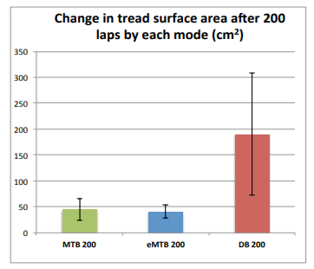
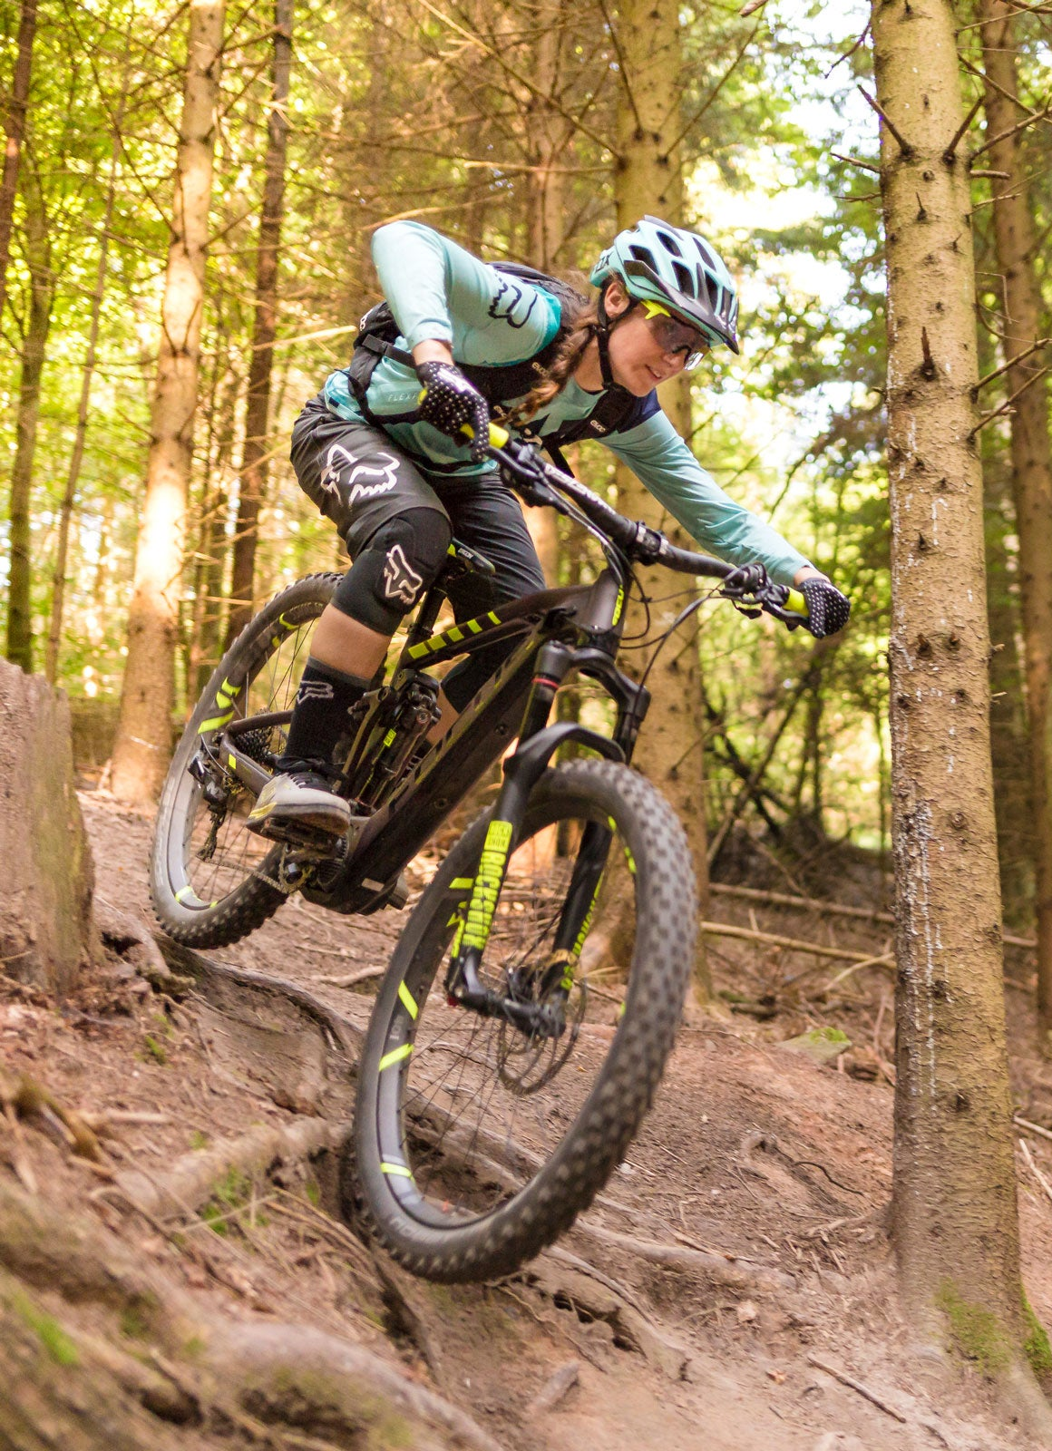
Environmental Impacts
Trail Degradation
A study completed by the International Mountain Bicycling Association found that impacts from Class 1
e-bikes and traditional mountain bicycles were not significantly different, while motorcycles led to much
greater soil displacement and erosion. Observations suggest that Class 1 e-bikes may lead to more
displacement under certain trail conditions, but more research is needed before conclusions can be drawn.
(NOTE: this is the only study done on the natural resource impacts of e-bikes.)
A study completed by the National Park Service, US Department of the Interior, found no significant impact
from the use of electric bicycles with the National Park System. There is no indication based on the
information in the PEA or elsewhere that would indicate impacts to soils, vegetation or wildlife from e-bike
use would affect the ability of current or future generations to enjoy park resources
or values.
Class 1, 2, and 3 e-bikes have clearly defined legal power outputs and functionalities.
However, electric motorbikes, sometimes colloquially referred to as e-bikes, can
weigh 2 to 3 times as much as a typical e-bike while outputting 5 to 10 times the
amount of power. As shown in the IMBA study, the high torque and weight of bikes
like Surron and Talaria (which are not legally e-bikes) can result in increased erosion,
deeper ruts and widening of trails in areas where these bikes are being used. Such
damage can take significant time and resources to repair.
Sources: https://cdn2.assets-servd.host/material-civet/production/images/documents/A-Comparison-of-Environmental-Impacts-from-Mountain-Bicycles-Class-1-Electric-Mountain-Bicycles-and-Motorcycles.pdf?dm=1620062866; file:///C:/Users/JohnBarrett/Downloads/FONSI_EBIKE%20PEA_PEPC.pdf; https://www.sciencedirect.com/science/article/pii/S2351989423001105; https://electrek.co/2025/01/20/the-problem-with-high-power-electric-bikes-on-mountain-bike-trails/

Slide 18
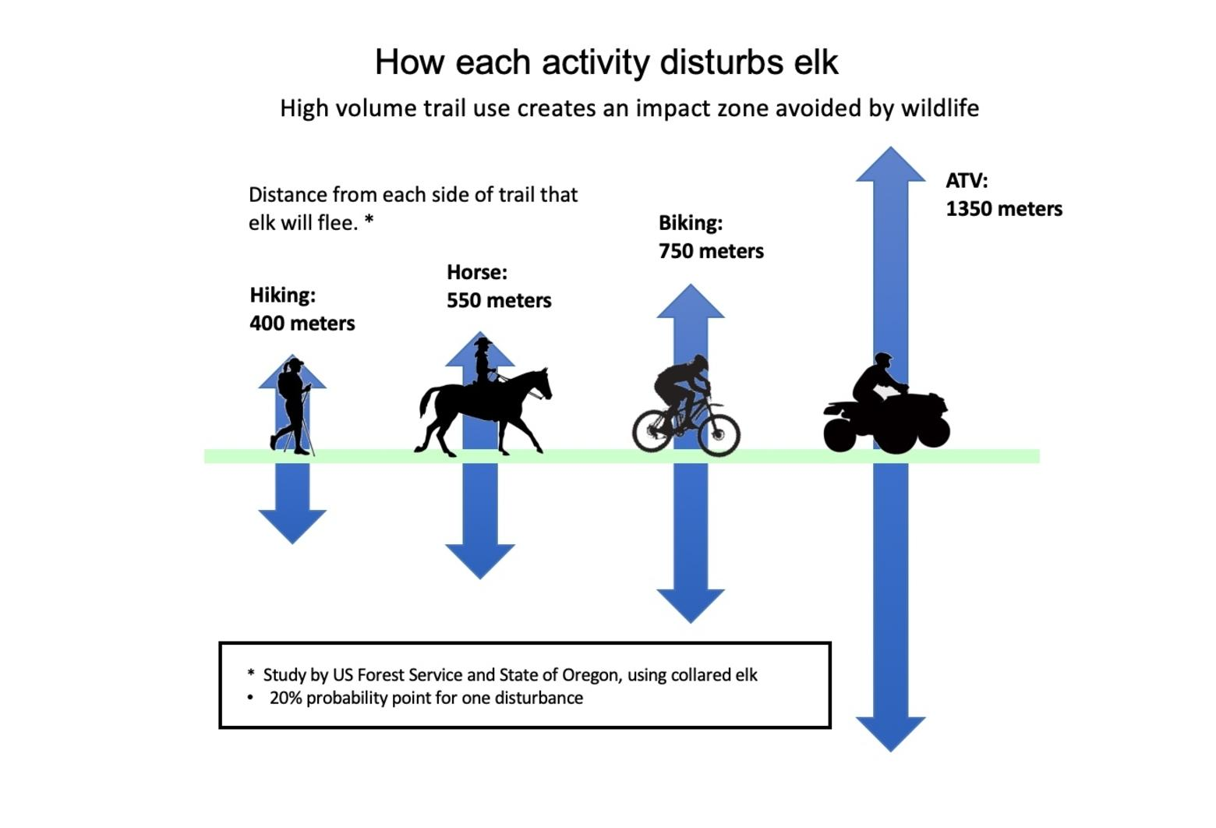
Environmental Impacts
Impact on Wildlife
A meta study by the Bayreuth Center of Sport Science concluded that direct impacts on wildlife are higher alert and flight response, and indirect responses may be seen in avoidance of trails leading to reduced habitat size (habitat compression) or habitat suitability and shifted activity patterns to more nocturnal activity. However, most effects result not solely from mountain biking as trails are mostly constructed for and used by other recreational activities. More severe consequences occur through off-trail trampling or riding and the formation of informal trails, which are further fragmenting habitats and increasing the area used by recreational activities. Findings show that responses of wildlife species are highly species-specific and so far, studies are biased towards carnivorous and herbivorous mammals with no studies on invertebrates or reptiles. While individuals are obviously disturbed, there is so far only scarce evidence for lower reproductive success or declining populations as a result of mountain biking activity.
Two studies on the impact of human on wildlife were completed by Colorado State University and the US Forest Service in eastern Oregon. Results showed, specifically with elk, a wide disturbance distance from the trail, with the results varying with activity. Wildlife flight response occurred at distances over 1000 meters for ATVs, 750 meters for mountain bikes, and 400 to 600 meters for horseback riding and hiking. Avoiding motors, wheels, hooves, or feet takes a toll on elk in two ways: increased energy expenditures and decreased access to food sources. Moving more than necessary and not having enough to eat can be detrimental to the viability of elk populations. Animals spend less time feeding and resting and more time running compared to when there was no human activity. Researchers concluded that human activity reduced carrying capacity – the number of animals that can make a living on the landscape.
Sources: https://www.sciencedirect.com/science/article/pii/S2351989423001105; https://mountainjournal.org/do-ebikes-represent-a-menace-to-wildlife-in-the-backcountry

Slide 19
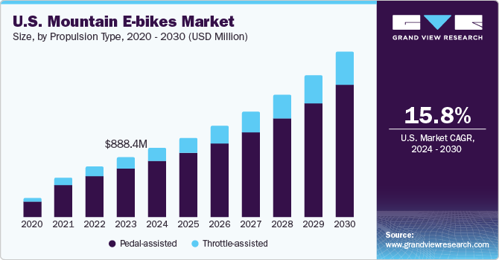
Environmental Impacts
Increased Trail Use
There are very few studies of e-bike trail usage. In 2022, the Fort Collins Bicycle Advisory Committee conducted an intercept survey of trail users. They also audited usage by mode of transportation. They found 34% of trail users were on bicycle, compared to 60% walking or jogging. Only 5% were on e-bikes. Interestingly, only 31% of survey respondents had seen an e-bike on a trail, and an additional 19% were unsure if they had seen an e-bike or not.
In 2023, e-bikes had a 5% share of the total bicycle market.
The US mountain bike market (excluding e-bikes) is estimated at $4.3B with a 10.8% CAGR. The US e-mountain bike market was $1.05B in 2023, with a 15.8% CAGR. That suggests that e-bikes currently account for 20% of mountain bike purchases. However, in 5 years and at those CAGRs, e-bikes will grow to 25% of total mountain bike purchases.
It is unknown what percentage of new e-bike purchases are new users and what percentage of e-bike purchases are current trail users purchasing additional bikes, and so the growth of the e-bike market does not correlate perfectly with increases in trail use. Regardless, if the intention of a trail is for public recreational use, increased usage should be viewed as a positive, and disallowing a particular subset of a user group from a trail simply to maintain the amount of traffic the trail experienced previously seems antithetical to the goals of a public recreation trail system (unless increased use of a trail is demonstrably harmed by a particular use case or user volume).
Sources: https://www.fcgov.com/bicycling/files/2022-e-bike-evaluation-report.pdf; https://www.coherentmarketinsights.com/industry-reports/mountain-bike-market; https://www.grandviewresearch.com/industry-analysis/us-mountain-e-bikes-market-report;

Slide 20
Environmental Impacts
Battery Production and Disposal
According to the Wall Street Journal, lithium-ion battery mining and production are worse for the climate than the production of fossil fuel vehicle batteries. China, which dominates the world’s EV battery supply chain, gets almost 60 percent of its electricity from coal—a greenhouse gas-intensive fuel. About 40 percent of the climate impact from the production of lithium-ion batteries comes from the mining and processing of the minerals needed. Production of the average lithium-ion battery uses three times more cumulative energy demand (CED) compared to a generic battery.
The disposal of the batteries is also a climate threat. If the battery ends up in a landfill, its cells can release toxins, including heavy metals that can leak into the soil and groundwater. A study from Australia found that 98.3 percent of lithium-ion batteries end up in landfills, which increases the likelihood of landfill fires that can burn for years. Only about 5 percent of the world’s lithium batteries are recycled compared to 99 percent of lead car batteries recycled in the United States.
Additionally, there are concerns about lithium batteries exploding, mostly during charging and mostly with aftermarket or DIY batteries and chargers, or due to using incompatible chargers for the battery. The risk to SCFC forests would be very minor, as the likelihood of a battery explosion while riding is minimal. It should be noted that gas engines are still significantly more likely to explode than lithium batteries during use.
The number of e-bikes sold in the US topped 1.5MM in 2024. This represents approximately 750 MWh of battery capacity in total. This compares to 120 GWh for all EVs sold in the US,160 times as much battery power. So, the impact from batteries of e-bikes is less than 1% of the impact from EVs.
Sources: https://www.instituteforenergyresearch.org/renewable/environmental-impacts-of-lithium-ion-batteries/; https://greenly.earth/en-us/blog/industries/the-harmful-effects-of-our-lithium-batteries; https://www.gzsamebike.com/e-bikes-dominate-u-s-market-growth-pricing-and-trends/; https://www.energy.gov/eere/vehicles/articles/fotw-1321-december-18-2023-e-bike-sales-united-states-exceeded-one-million; https://www.ecycleelectric.com/blog/2025/2/12/how-big-is-the-usa-e-bike-market-in-2024-25;

Slide 21
Environmental Impacts
Reduction in Car Traffic
Of the lifetime emissions of an e-bike, 75% are produced during the materials and manufacturing process, 15% during the actual use of the e-bike, and the remaining 10% during transport.
An individual e-bike can reduce CO2 emissions by 225 kilograms yearly when replacing car trips. Moreover, e-bikes are up to six times more efficient than trains.
E-bikes are also cost-effective. It costs about 6.5 cents to charge a decent-sized e-bike battery fully.
E-bikes can be recycled. The recycling process involves dismantling the e-bikes into their raw components and removing lithium-ion batteries to mitigate potential hazards. Recycling services, such as Velorim Recover, have emerged to dispose of end-of-life e-bike batteries safely.
Transport Mode | Average CO2 Emissions per Passenger-km
Car (Petrol) | 104g CO2e
Bus | 68g CO2e
Electric Bike | 22g CO2e
Source: https://www.greenmatch.co.uk/electric-bikes

Slide 22
Safety Impacts
There are no major safety concerns around e-bikes that suggest their use should be disallowed
Concern | Legitimacy | Relevancy | Sentiment
Speed and Control | Moderate | High | Downhill speeds are not different between e-bikes and analog bikes, but ascent and flat terrain speeds are approximately 5 miles an hour faster on average. Regardless, e-bike speed and analog bike speed both correlate more strongly to rider experience than to the bike used.
Weight and Momentum | Low | Moderate | E-bikes are heavier than their comparable analog bikes, but both e-bikes and analog bikes have wide ranges of weights and the presence of a motor does not mean that an e-bike would inherently be heavier than other analog bikes currently on the trail. Additionally, weight has been found to increase the stability of a bike and can decrease the rate of crashes.
Mitigating Risk
Helmet Requirements | Helmet mandate legislation is effective, with an estimated 20% reduction in head injuries and a larger effect with more severe injuries. Requiring the use of motorcycle helmets that protect both the skull and neck should be considered for faster e-bikes (Class 3).
Trail Reviews | When determining what trails to allow e-bikes on, consider what potential blind spots or technical sections of trail could cause safety hazards for bikes moving faster than analog traffic. Narrow sections of trail with blind spots or minimal safe lines create risk for other trail users and riders if e-bikes are able to enter those trail sections at a higher speed. Trail assessments should consider the safety of all sections of the trail in all legal directions of travel, but special consideration should be given to trail ascents, as this is where e-bikes will have a significant speed advantage over analog bikes and where their trail use will most significantly differ.
Education | Education around appropriate speeds and trail etiquette may reduce tension with other user groups. However, emerging research suggests that e-bike users display similar trail etiquette as analog riders, with the caveat that they are more likely to cede right of way.
Source: ACS

Slide 23
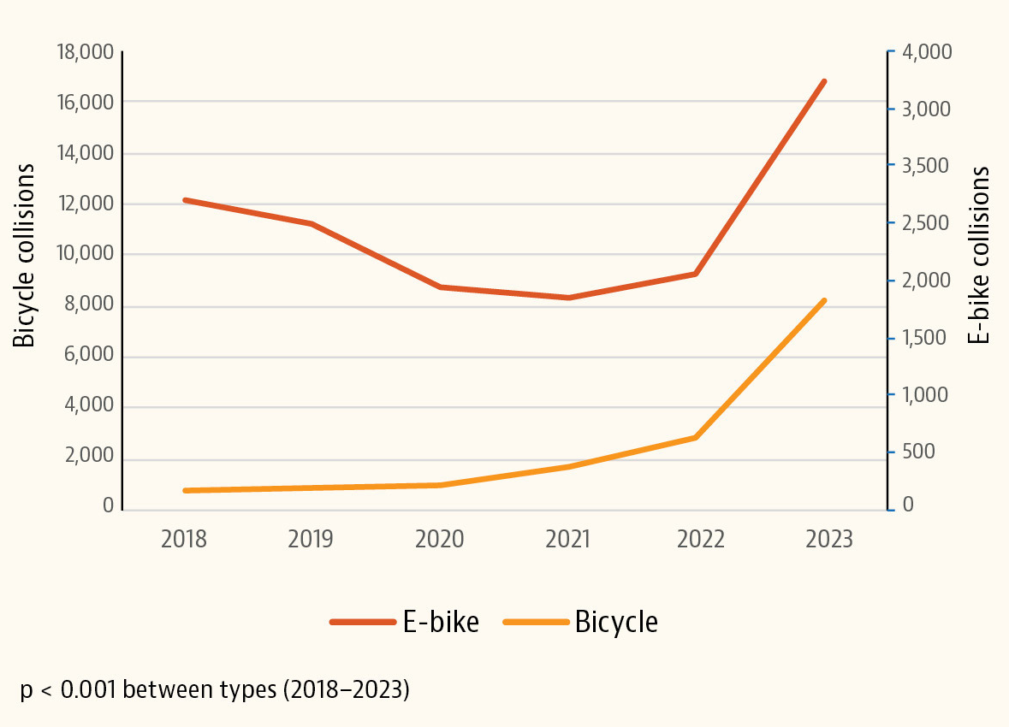
Safety Impacts
Speed and Control
In February 2024, US researchers reported a dramatic 49-fold increase in e-bike riders with head trauma nationally over the past 5 years, which they attribute to a lack of safety regulations like mandatory helmets, speed limits for e-bikes, and age restrictions. It should be noted that this increase is not mountain bike-specific and the cited reasons for the increase in injuries (increased e-bike delivery services, bidirectional bicycle lanes, riding in traffic, and a proliferation of e-bike city rentals) are not applicable to mountain bike riding.
Dependent on the class of e-bike, novice riders may be able to reach speeds on an e-bike that are unsafe for their level of experience. The ability to ride flat trails and trail ascents at a faster speed may also introduce new risks, as technical and uneven trail sections may be approached at unsafe speeds that a rider would not be able to replicate on a non-motorized bike.
This risk would be user-dependent with Class 1 and 3 e-bikes, as the amount of assistance (and therefore probable speed) is dependent on the user’s settings, but because speed is dependent on the user’s pedaling, the likelihood that a user would reach an unsafe speed on an ascent is minimal on a Class 1 bike, and moderate on a Class 3 bike. The risk would be significantly higher with Class 2 e-bikes, which would allow a user to throttle up to 20 mph regardless of their own pedaling output.
On descents, the risk of e-bikes from a safety perspective is not meaningfully different than on non-motorized bikes, as riders are often able to exceed 20-28 mph regardless.
Source :American College of Surgeons, Bosch, National Library of Medicine

Slide 24
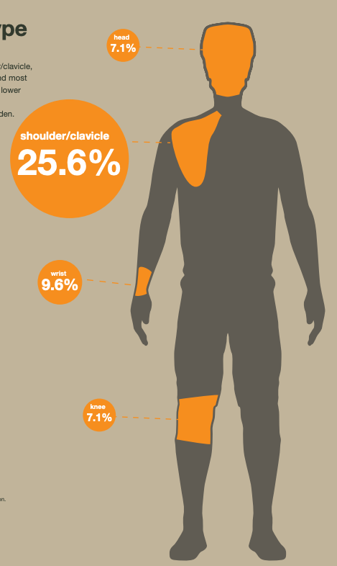
Safety Impacts
Weight and Momentum
The heavier a bike is, the more momentum it has and the longer it takes to come to a complete stop. E-bikes are definitionally heavier than their comparable non-motorized bike counterparts, as they have the same components plus the weight of a motor and battery. However, there are not standard weight parameters for non-motorized mountain bikes, and a heavy non-motorized bike may weigh more than a lightweight, high-end e-bike, negating concerns about weight and momentum. The weight difference between a standard bike and a comparable e-bike is roughly 13-22 lbs., which is a smaller range than the weight differences across riders a non-motorized bike is designed to handle.
E-bike injury patterns are more consistent with injury patterns sustained by traditional cyclists, not injury patterns sustained from motorcycle accidents or other motorized vehicle accidents. A 2021 study found that patients with e-bike accidents were almost 14 years older and had a higher incidence of moderate traumatic brain injuries than patients with bicycle accidents, in spite of the fact that e-bike riders were nearly twice as likely to wear a helmet as compared to bicycle riders. However, researchers suggested that this higher incidence rate is likely causally related to the age of the e-bike riders (e-bikes are more accessible to older people than analog bikes), and that their higher rate of traumatic brain injuries is a result of the increased likelihood of serious injuries due to a fall as people age.
The rate of pelvic injuries in e-bike accidents was twice as high compared with bicycle accidents, whereas the rate of upper extremity injuries was higher following bicycle accidents. Again, study authors hypothesized that the older age and lower skill level of the average e-bike user compared to the average cyclist accounted for the differences in these accidents. However, e-bike riding on mountain biking trails would likely not attract the same population of users, and so we hypothesize injury patterns would be more akin to standard mountain bike injury patterns (shown to the right) than the injury patterns of elderly e-bike riders on paved trails and public roads. E-bike users are also less likely to crash in the first place (it is hypothesized that the additional weight at the center of the bike increases stability and facilitates better traction).
Source :American College of Surgeons, Bosch, National Library of Medicine

Slide 25
Social Impacts
The positive social effects of e-bikes outweigh the potential negatives, which are user-dependent and can be addressed via education
Concern | Legitimacy | Relevancy | Sentiment
Accessibility | High | High | Allowing Class 1 e-bikes avoids potential ADA compliance issues.
User Behavior | Moderate | High | Research suggests that user behavior is dependent on the user, not the type of bike.
Community Effects | Low | High | There are positive health benefits associated with the socialization and community of riding bikes. Concerns that some users will discriminate against e-bike users are valid but speak to the need for education around e-bikes, not the need to amplify that discrimination by limiting access.
Other Considerations
Health Benefits | Because people on e-bikes tend to ride longer than they otherwise would on analog bikes, the cardiovascular benefits of e-bike use are comparable to standard bikes, and e-bikes may serve as an introduction or reintroduction to healthy movement for people who are otherwise sedentary, which would increase the overall health and well-being of the community.
Increased Engagement with the Outdoors | Because a percentage of users are exclusively e-bike riders, allowing e-bikes in SCFC forests provides access and incentive to engage with outdoor spaces and the natural environment for a new user group.
Source: ACS

Slide 26
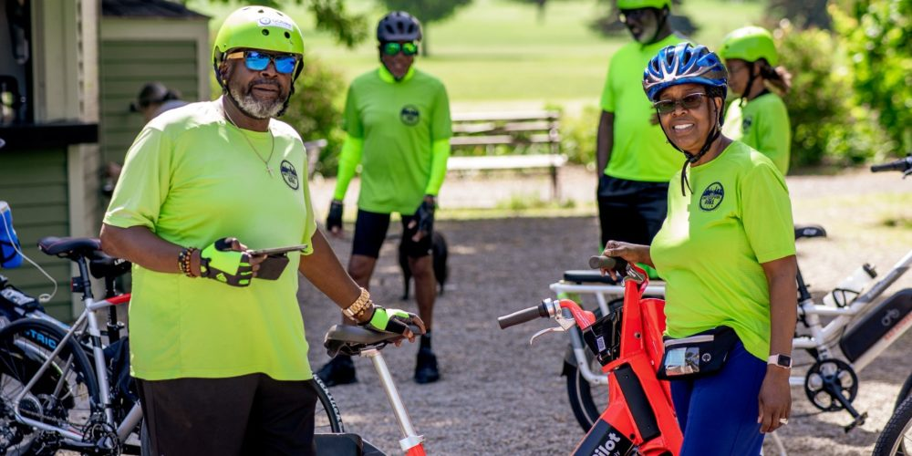
Social Impacts
Accessibility
The ADA grants access to “Other power-driven mobility devices” which are defined as, “any mobility device powered by batteries, fuel, or other engines… that is used by individuals with mobility disabilities for the purpose of locomotion, including golf cars, electronic personal assistance mobility devices… or any mobility device designed to operate in areas without defined pedestrian routes, but that is not a wheelchair.”
Further, the ADA says that "People with disabilities have the right to choose whatever mobility device best suits their needs.” The Department of Justice, Civil Rights Division defines the term ‘‘other power-driven mobility device'' as ‘‘any of a large range of devices powered by batteries, fuel, or other engines— whether or not designed solely for use by individuals with mobility impairments—that are used by individuals with mobility impairments for the purpose of locomotion, including golf cars, bicycles, and electronic personal assistance mobility devices.”
To avoid legal challenges, SCFC would need to allow an e-bike rider access: “if the person presents a valid, State-issued disability parking placard or card or a
State-issued proof of disability, that must be accepted as credible assurance on its face. If the person does not have this documentation, but states verbally that the OPDMD is being used because of a mobility disability, that also must be accepted as credible assurance, unless the person is observed doing something that contradicts the assurance. For example, if a person is observed running and jumping, that may be evidence that contradicts the person’s assertion of a mobility disability. However, it is very important for covered entities and their staff to understand that the fact that a person with a disability is able to walk for a short distance does not necessarily contradict a verbal assurance – many people with mobility disabilities can walk, but need their mobility device for longer distances or uneven terrain. This is particularly true for people who lack stamina, have poor balance, or use mobility devices because of respiratory, cardiac, or neurological disabilities. A covered entity cannot ask people about their disabilities.”
Due to enforcement issues, it is likely easier and less legally-perilous to allow Class 1 e-bikes to all riders, so SCFC does not have to manage asking about ADA compliance on an individual user basis.

Slide 27
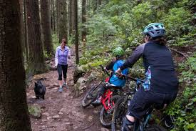
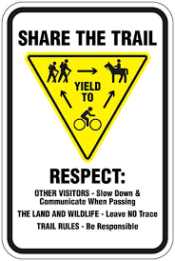
Social Impacts
User Behavior and Trail Etiquette
In Jefferson County, Colorado, e-bikes are allowed on most singletrack trails following a trial period to solicit community feedback and monitor for issues related to things like user conflicts. Perhaps most tellingly, a 2017 survey of Jefferson County found 65% of trail users were unable to detect the presence of a Class 1 e-bike vs. a regular mountain bike, speed differential or not. Limited research has been done on the effects of e-bikes on trail etiquette, but preliminary findings suggest that trail etiquette is correlated with the user, not the presence of a motor on their bike. The one exception to this finding is that riders report e-bike users are more likely to cede right of way to other users and user groups, even when they technically have right of way. E-bike riders explained that they were willing to dismount their bikes and allow others to pass because restarting on an e-bike, even on
an ascent, is much easier than on an analog bike.
EMBA announced at its annual member meeting held virtually on December 6, 2022, that the organization was adjusting its stance on e-bikes to encourage land managers to take an “open unless signed closed” approach to adopting Class 1 e-bikes on trails
already open to mountain bikes. The move is a reversal of its previous “closed unless signed open” recommendation and comes after years of collecting input from hikers, equestrians, mountain bikers, land managers, and other members of Washington’s outdoor recreation community.
One remaining concern is the development of illegal trails. While e-bike users and analog users are equally likely to engage in illegal trail development, e-bike users have more ability to climb steep, technical sections. Unregulated development of these types of trails could create an outsized impact on erosion and environmental disruption because of the kinds of trails e-bike users are more likely to cut.
Source: https://www.singletracks.com/mtb-trails/are-class-1-e-bikes-too-fast-for-certain-trails-some-think-so/, https://www.sciencedirect.com/science/article/pii/S2351989423001105

Slide 28
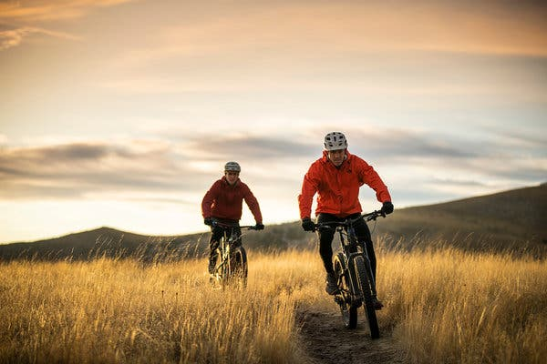
Social Impacts
Community Effects
Positive Social Aspects:
Inclusivity and Accessibility: E-bikes make cycling more accessible to a wider range of people, including those with disabilities or older adults, and can encourage physical activity.
Increased Socialization: E-bikes can foster social connections, as they allow individuals to enjoy trails with friends and family, especially those with varying fitness levels.
More Diverse User Base: E-bikes can lead to more diverse user groups on trails, potentially leading to a greater understanding and appreciation for different riding styles and experiences.
Negative Social Aspects:
Perception of "Cheating": Some traditional cyclists view e-bikes as a form of cheating or as diminishing the physical effort and accomplishment associated with trail riding.
Potential for Conflict: Differing opinions about e-bike use on trails can lead to conflict and division within cycling communities.
Concerns about Speed and Safety: Some users worry that e-bikes could pose safety concerns for other trail users, especially if riders exceed trail speeds.
Focus on Accessibility: Some argue that prioritizing e-bikes for accessibility could unintentionally marginalize the needs and experiences of traditional cyclists.

Slide 29
Contents
Project Background
Current Regulation
Impact of E-Bikes
Case Studies
Conclusions

Slide 30

Case Study
Pennsylvania Bureau of State Parks
E-bikes are allowed on DCNR-managed motorized trails and public use roads unless they are marked as prohibited to bikes. E-bikes are allowed on trails already open to traditional bicycle usage as long as users follow guidelines consistent with the Pennsylvania Vehicle Code that e-bikes:
  Weigh no more than 100 pounds,
  Do not exceed 20 miles-per-hour using the motor,
  Have motors that do not exceed 750 watts,
  Have fully functional, operable pedals.
E-bike users must propel their e-bikes by pedaling on non-motorized trails; the use of the throttle-only functionality is not permitted on non-motorized trails managed by DCNR.
State forest roads and trails that are not open to biking, which would also prohibit e-bikes include:
  Natural areas,
  Designated hiking trails (blazed with yellow or orange),
  Trails or roads specifically marked closed to biking,
  Other lands open to the public in Pennsylvania (such as federal lands, local parks, gamelands, and preserves) have different requirements related to e-bikes. E-bike users should check the guidelines for their destination before they go.

Slide 31
Case Study
Conversation with Rory Bower, General Manager, Pennsylvania Bureau of State Parks
Property under our management includes all state parks and forests – 2 mm acres, 125 state parks. The use of e-bikes is certainly growing – more showing up all the time.
I answer all of the correspondence for Bureau of State Parks and I have heard no negative comments since instituting the policy a couple of years ago. (We try to review every policy on a five-year cycle.) Heard some positive comments. But people generally don’t make positive comments! Overall, we think it has been fairly well received. Biggest problems is that it is hard to gauge people riding on trails that aren’t open to bikes – e.g. hiking trails. We can’t be all places at all times.
The only issue that exists – we are struggling with right now, is on paved, multi-use trails, where you have people walking dogs, roller blading, strollers, other bikes. There are so many people utilizing the trails, at different speed, and the speed of e-bikes has become problematic. Even pedal bikes, especially in areas with sharp turns. Controlling speed on e-bikes speed is not a good way. Allowing e-bikes has increased the number of incidents and accidents – on trails in general because people are going fast and there is no good way to slow them down. We have tried putting up signs, but most bikes don’t have speedometers anyway.
Speed is impossible to enforce. The only thing we can enforce is where people are allowed and not allowed to ride. Also the type of bike – if bike is not in compliance. Penalties are tough to levy because it is Bureau policy and they are not legally enforceable. We are in the process of revising rules and regulations and may look at putting something stronger in for enforcement. But we can’t legally enforce anything right now.
One thing that happened internally – at the Bureau of Forestry – they do a lot of logging and they put in a road and then when they are done logging, they put a gate on it. In the past, the BoF closed those roads to motorized vehicles. E-bikes have electric motors and so their presence on these BoF roads is, in effect, against their regulations. That has caused some internal issues with folks in Forestry and they fought internally against e-bikes being allowed on their roads (and lost).

Slide 32

Case Study
Minnesota Department of Natural Resources
Electric-assist or pedal-assist bicycles are allowed on state trails, or wherever normal bicycles are allowed, if they meet the following definition in Minnesota Statutes 169.011, Subdivision 27:
  2 or 3 wheels,
  A saddle and fully operable pedals for human propulsion,
  Equipped with an electric motor that has a power output of not more than 750 watts, and
  Meets the requirements of a class 1, class 2, or class 3 electric-assisted bicycle.
A motorized bicycle that does not meet the definition of an electric-assist bicycle is not allowed on state trails where motorized vehicles are prohibited.
When riding on state trails, riders are asked to yield to pedestrians and slower trail users, and give an audible signal if passing.
The law does not permit anyone under the age of 15 years to operate any electric-assist bike.
Definitions of e-bike classes follow the PeopleForBikes classification system adopted by many states.
Hiking is allowed on mountain bike trails, unless posted as restricted. Hikers follow the same rules as cyclists. When it rains, trails will be immediately closed to all users (foot or bike) until trail conditions dry out or improve.

Slide 33
Case Study
Conversation with Wade Miller, State Trails Consultant, Minnesota Dept. of Natural Resources
DNR is vast agency and within that we have units. I work for parks and trails. We manage trails, parks and water access. We also have forestry division that also would manage e-bike usage. Also wildlife management lands may be more restrictive. Each land management division may have a different rule as it relates to e-bikes. The State of Minnesota e-bike law that states unless it is Class 1, 2, or 3 it is not allowed in our recreation system. You can use it for transportation purposes like other e-bikes. But for recreation purposes, only class 1, 2, or 3 are allowed on our trails. That is a law. We don’t have a policy developed at this point that is more restrictive.
The use of e-bikes has more than doubled since our last survey. The grand total number of users on state rails using a bicycle was 60%. Of that 60%, 19% were on e-bike and 25% on traditional bike.
Having been in recreation business for over 20 years, I’ve seen several situations like this. Whenever there are new types of recreation devices there are pros and cons. We as state government are not too quick to react unless it is first and foremost a safety concern. We have been functioning under the law and continue to observe and conduct surveys every other year to influence potential policy development or restrictions. The 2024 survey was the first year we incorporated a significant number of e-bike questions. Those results and our general data do not suggest any safety concern we need to address immediately. There are a lot of perceptions, and those with negative perceptions tend to be more vocal. There are tons of emails that e-bikes are overtaking the biking world. Folks on the ground don’t perceive the same level of conflict. We saw the same thing with mountain bikes. When fat tire bikes started to hit the market there was concern over safety and higher injury rates. That came and went and we didn’t see significant increase in injury. E-bikes are heavier and faster, but we don’t see data supporting higher injury. We are seeing non e-bikes and e-scooters and other devices where folks may not be aware they are not allowed.
We hear folks that appreciate the DNR not reacting in knee-jerk manner when it is relatively new. We don’t know to what point the capacity for e-bike growth or trail density will continue – it is growing. When things grow, people tend to get nervous at the thought of change. We are hearing that they are glad we are not doing what some other states are doing, but also disappointed that the DNR is not saying no to change. State government is probably in a good place when nobody is completely satisfied. But there is also no data that we need to make a significant change. We are not seeing accident reports, etc. in the data. We are hearing perception of folks seeing people going faster than what they feel they should be capable of on an e-bike, but no evidence of it.

Slide 34
Case Study
Conversation with Wade Miller, State Trails Consultant, Minnesota Dept. of Natural Resources
As you get further away from urban setting, speed increases but there are less users that are impacted by it. That is consistent with our survey results. As you are further away from population centers, there is also less concern over usage or conflict.
Our policy today is a statute. Until the legislature services it, or the DNR wishes to be more restrictive, and unless there is a significant uptick in the incidence rate, we don’t have a timeline or routine policy revision timeline. Because we do surveys every two years, we take a look at information and that informs us if we need to consider a rule or policy change in our system. E-bikes is a portion of our system, like fishing regulations on given lake. If data suggests an issue, then that becomes a priority. We have not hit that threshold that would take e-bikes to a top-shelf for enforcement or rule changing. We are in an observation data capture and management state, not trying to establish something if there is not a need. The last thing we want to do is establish something and miss the goal post in some way.
If we eliminated e-bikes then you have to go down the list of other means of transportation. Then you have Commerce with concerns of government taking steps to reduce opportunities in the economy and general freedom of people exercising their right to go outdoors. DNR has established an initial rule of Class 1, 2, or 3 only allowed on our trails.
Practically there is no excellent way to enforce it. There is always the law someone could be cited as violating. We don’t have speed limits on state trails. For example, if you go 30mph on regular road bike on our trails, that’s legal. But if you’re going faster than 28 mph on an e-bike that is a legal offense and you can be cited. We don’t have enough law enforcement to police our roads, streets, communities, natural resource areas. But law enforcement focuses on where there is a need. We haven’t had the need based on accidents, injuries, etc. that has caused us to refocus enforcement activity specifically to e-bikes.

Slide 35
Contents
Project Background
Current Regulation
Impact of E-Bikes
Case Studies
Conclusions

Slide 36
Overall Findings
Class 1 e-bikes are similar to analog bikes and should be regulated similarly; Class 2 and 3 e-bikes may introduce issues into the system for other user groups
 | Class 1 | Class 2 | Class 3
Trail Degradation | Research shows not meaningfully different from analog bikes | Throttle/consistent 20mph speed could cause increased erosion | Research shows not meaningfully different from analog bikes
Impact on Wildlife | Research shows not meaningfully different from analog bikes
Increased Trail Use | Currently accounts for ¼ of all new mountain bike purchases, but some percentage of those purchases are replacing rides with analog bikes
Speed and Control | Descent speed similar to analog, climbing and flat speed above analog, speed attached to pedaling | Allows for consistent speeds, may be dangerous on some trails | Allows for higher speeds, may be dangerous on some trails
Weight and Momentum | Not inherently heavier than other analog bikes on the trail, weight can increase stability
Accessibility | Meets ADA standards for reasonable accommodations on bike-accessible trails | Not considered a reasonable ADA accommodation
User Behavior and Trail Etiquette | Research shows behavior is similar to analog riders, with the exception that e-bike riders are more likely to cede right of way | Concerns that riders purchasing Class 2 and 3 do so for the additional/consistent power, may attract unsafe riders
Community Effects | Positive health benefits, minimal negative effects/negative effects are based on misconceptions of e-bikes | Positive health benefits, but Class 2 and 3 may attract unsafe riders and exacerbate community relations

Slide 37
Recommendations
Allow Class 1 e-bikes: The difficulty of even determining which bikes are e-bikes vs. analog will limit enforceability of any Class 1 ban. Additionally, all research suggests that Class 1 bikes are not meaningfully different in appearance, user base, or effects on trails/wildlife than analog bikes, so it is hard to justify allowing one and not the other. Allowing Class 1 seriously limits the potential for future litigation, as Class 1 can be defined using ADA guidelines as a reasonable accommodation for mountain biking, while Class 2 and Class 3 are not reasonable accommodations (as they have effects on the trail that can be avoided via use of a Class 1 e-bike). Allowing Class 2 and Class 3 mountain bikes could introduce problems such as unsafe speeds, populations prone to unsafe behaviors, and trail erosion that would complicate enforcement and become continuing issues that could ultimately limit accessibility for other user groups (hikers, horseback riders, analog riders, etc.).
Assess trails for safety: Most trails safe for mountain biking are safe for Class 1, but review all current legal mountain bike trails and confirm that any trails with steep or technical ascents, narrow bidirectional pathing, blind turns, or any other features that could create issues at greater speeds are safe for Class 1. Our recommendation is to utilize e-bike users, analog mountain bikers, and trail builders in your assessments of trail safety to ensure that assessments align with true use patterns. If a trail is deemed unsafe, we recommend either making minor trail adjustments (if this does not limit access/significantly change lines and pathing for analog riders) or identifying that trail as illegal for all e-bikes and posting clear signage at the start of those trails and on maps.
Determine enforcement guidelines: We recommend focusing on user behavior as opposed to regulating the specific bikes used by users. For instance, a person with a Class 2 bike could choose to disengage the throttle and use exclusively pedal-assist; provided that person is operating the bicycle within the bounds of a Class 1 bike and operating safely, there is no need to enforce the Class 2 ban on that person. We recommend continuing to ban Class 2 and Class 3 bikes, but in practice only pulling over/examining e-bikes for legality when the user is engaged in unsafe behavior.

Slide 38
Other Enforcement Considerations
General Enforcement: Bans will be on classes of e-bikes (2, 3, and unclassed), but enforcement efforts will be focused on removing unsafe users. Analog bike users and Class 1 riders should still be warned/fined if they are engaging in unsafe behaviors. If there is damage to trails due to banned Class 2 bikes (greater erosion, etc.) then enforcement of Class 2 bans may need to occur.
  Training: Rangers will need to be trained on the different classes of e-bikes, how to tell which class an e-bike is, and identify unclassed e-bikes. Rangers will need to be able to articulate to potential users the justifications for not allowing Class 2 and 3 (additional damage to trails that is resource-intensive to fix, ease of reaching unsafe speeds for some trails, etc.)
  Signage: Maps, trailhead markers, and websites should clearly label which trails are closed to e-bikes, if any. If after trail review, more trails than not are illegal for e-bikes, it may be more cost-effective to adopt a “closed unless marked open” policy and make signage for trails that are open to e-bikes. It may also be of benefit to edit any existing signage (or add signage) that is intended to educate the public about trail etiquette, (such as calling out when passing, maintaining appropriate speeds, etc.) and reactions to e-bike use (reminders to remain courteous to others trail users, identifying reasons people may opt to use e-bikes over analog bikes to educate communities who may feel e-bikes are “cheating,” etc.).
  Fines: We recommend fining repeat offenders who are engaging in unsafe behavior. This will hopefully address some community concerns about the presence of e-bikes and will serve to keep access open for those users who are riding their e-bikes responsibly.
  Modified bikes: For ease of enforcement and to ensure access to responsible riders, we suggest focusing on the features of the bike as opposed to whether the bike is in factory-state or if it has a class sticker. An analog bike that has a pedal-assist speed limit of 20 mph and no throttle, for instance, can be ridden even though it was not sold as a Class 1 bike. If a Class 2 bike disengages the throttle or a Class 3 bike sets their speed limit to 20 mph, we recommend initially allowing these modifications unless user behavior is unsafe.
  Policy review: We recommend developing a cadence for reviewing e-bike policies, potentially once every two years for the first few cycles and then up to every five years once e-bikes are an established presence. If e-bikes introduce more problems than benefits, it may be necessary to more strictly enforce Class 2 and 3 bans or to limit Class 1 riders to people with disabilities whose e-bike use is protected by the ADA. Alternatively, SCFC may opt to open trails to Class 2 and 3 once further research is available.

Slide 39
Comments / Questions?

Slide 40

Priority Metrics Group
History of helping our clients grow
Company Overview
Formed in 1993 PMG began in order to bridge the gap between market research and business strategy. Grown Through High Value Services Generating insight and growth for our clients has enabled PMG’s growth. PMG Customer Insight™ PMG’s initial focus was on customer satisfaction and value and the range of services expanded based on client demand.
Since 1993, PMG has consistently delivered high value solutions through our practical approach to any organizational issue. PMG principals have a wealth of real-world experience in marketing strategy development and implementation, market research, market analysis, competitive intelligence, innovation, commercial due diligence, new product development and business growth.

